Slide 1
Security Bug Detection

Slide 2

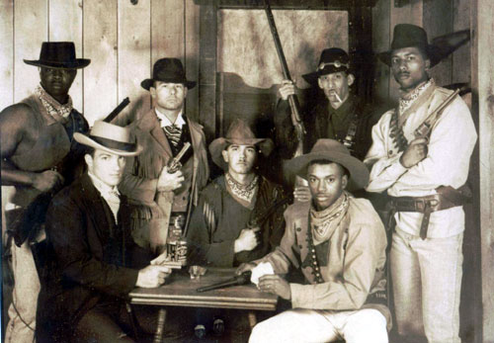
Vulnerability Finding Today
Security bugs can bring $500-$100,000 on the open market
Good bug finders make $180-$250/hr consulting
Few companies can find good people, many don’t even realize this is possible.
Still largely a black art

Slide 3
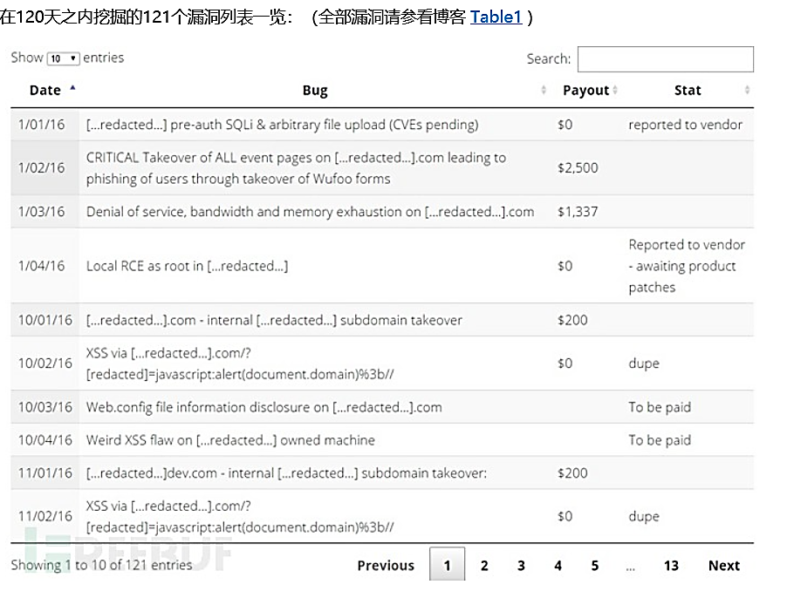
Notes:
https://www.freebuf.com/articles/web/111139.html
白帽笔记：我的“一日一洞”高效漏洞挖掘之旅

Slide 4
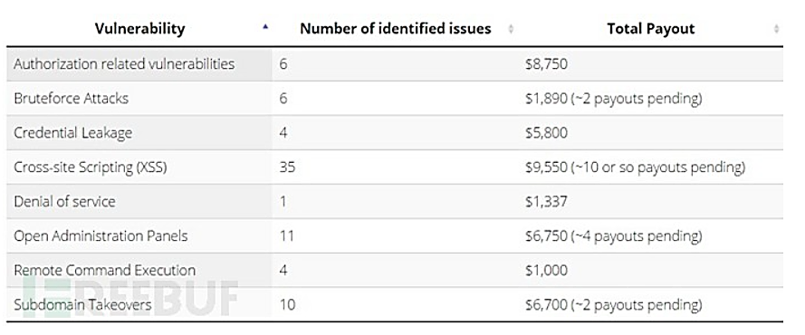

Slide 5
Security Vulnerabilities
What can Security bugs an attacker do?
  avoid authentication
  privilege escalation
  bypass security check
  deny service
  run code remotely

Slide 6
Why not eliminate bugs all together?
Impractical in general
  Formal verification is hard in general, impossible for big things.
Why don’t you just program in Java, Haskell, <your favorite safe language>
  Doesn’t eliminate all problems
  Performance, existing code base, flexibility, programmer competence, etc.
Not cost effective
  Only really need to catch same bugs as bad guys

Slide 7
Bug Patterns
Most bugs fit into just a few classes
  Some lend themselves to automatic detection, others don’t
Which classes varies primarily by language and application domain.
  (C/C++) - Memory safety: Buffer overflows/integer overflow/double free()/format strings.
  Web Apps - Cross-Site Scripting

Slide 8
More Bug Patterns
Programmers repeat bugs
  Copy/paste
  Confusion over API
    e.g. linux kernel drivers, Vista exploit, unsafe string functions
  Individuals repeat bugs
Bugs come from broken assumptions
  Trusted inputs become untrusted
Others bugs are often yours
  Open source, third party code

Slide 9
Bug Finding Arsenal
Threat Modeling: Look at design, write out/diagram what could go wrong.
Manual code auditing
  Code reviews
Automated Tools
Techniques are complementary
  Few turn key solutions, no silver bullets

Slide 10
What this talk is about
Using tools to find bugs
  Major techniques
  Some tips on how to use them
Static Analysis
  Compile time/source code level
  Compare code with abstract model
Dynamic Analysis
  Run Program/Feed it inputs/See what happens

Slide 11
Static Analysis

Slide 12
Two Types of Static Analysis
The type you write in 100 lines of python.
  Look for known unsafe string functions strncpy(), sprintf(), gets()
  Look for unsafe functions in your source base
  Look for recurring problem code (problematic interfaces, copy/paste of bad code, etc.)
The type you get a PhD for
  Buy this from coverity, fortify, etc.
  Built into visual studio
  Roll your own on top of LLVM or Pheonix if your hardcore

Slide 13
Static Analysis Basics
Model program properties abstractly, look for problems
Tools come from program analysis
  Type inference, data flow analysis, theorem proving
Usually on source code, can be on byte code or disassembly
Strengths
  Complete code coverage (in theory)
  Potentially verify absence/report all instances of whole class of bugs
  Catches different bugs than dynamic analysis
Weaknesses
  High false positive rates
  Many properties cannot be easily modeled
  Difficult to build
  Almost never have all source code in real systems (operating system, shared libraries, dynamic loading, etc.)

Slide 14
Example: Where is the bug?
int read_packet(int fd)
{
char header[50];
char body[100];
size_t bound_a = 50;
size_t bound_b = 100;
read(fd, header, bound_b);
read(fd, body, bound_b);
return 0;
}

Slide 15
Example: Where is the bug?
int read_packet(int fd)
{
char header[50]; //model (header, 50)
char body[100]; //model (body, 100)
size_t bound_a = 50;
size_t bound_b = 100;
read(fd, header, 100);
read(fd, body, 100);
return 0;
}

Slide 16
Example: Where is the bug?
int read_packet(int fd)
{
char header[50]; //model (header, 50)
char body[100]; //model (body, 100)
size_t bound_a = 50;
size_t bound_b = 100;
read(fd, header, 100); //constant propagation
read(fd, body, 100); //constant propagation
return 0;
}

Slide 17
Example: Where is the bug?
int read_packet(int fd)
{
char header[50]; //model (header, 50)
char body[100]; //model (body, 100)
size_t bound_a = 50;
size_t bound_b = 100;
//check read(fd, dest.size >= len)
read(fd, header, 100); //constant propagation
read(fd, body, 100); //constant propagation
return 0;
}

Slide 18
Example: Where is the bug?
int read_packet(int fd)
{
char header[50]; //model (header, 50)
char body[100]; //model (body, 100)
size_t bound_a = 50;
size_t bound_b = 100;
//check read(fd, 50 >= 100) => SIZE MISMATCH!!
read(fd, header, 100); //constant propagation
read(fd, body, 100); //constant propagation
return 0;
}

Slide 19
Rarely are Things This Clean
Need information across functions
Ambiguity due to pointers
Lack of association between size and data type…
Lack of information about program inputs/runtime state…

Slide 20
Rarely are Things This Clean
Need information across functions
Ambiguity due to pointers
Lack of association between size and data type…
Lack of information about program inputs/runtime state…
Static Analysis is not a panacea, still its very helpful especially when used properly.

Slide 21
Symbolic Execution

Slide 22
符号执行
符号执行技术的核心思想是使用符号值来表示程序的输入数据，并将程序的运算过程逐指令或逐语句地转换为数学表达式，在CFG的基础上生成符号执行树，并为每一条路径建立一系列以输入数据为变量的符号表达式。

Slide 23
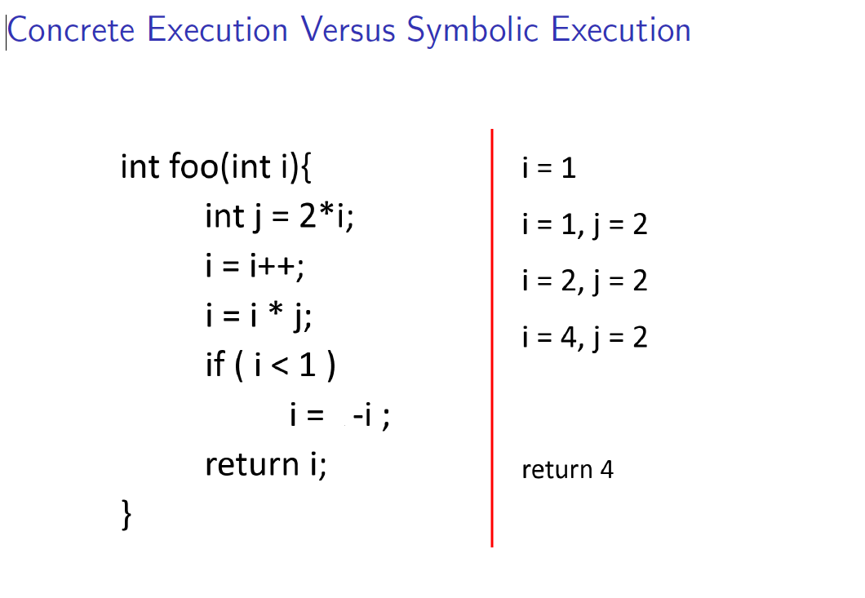

Slide 24
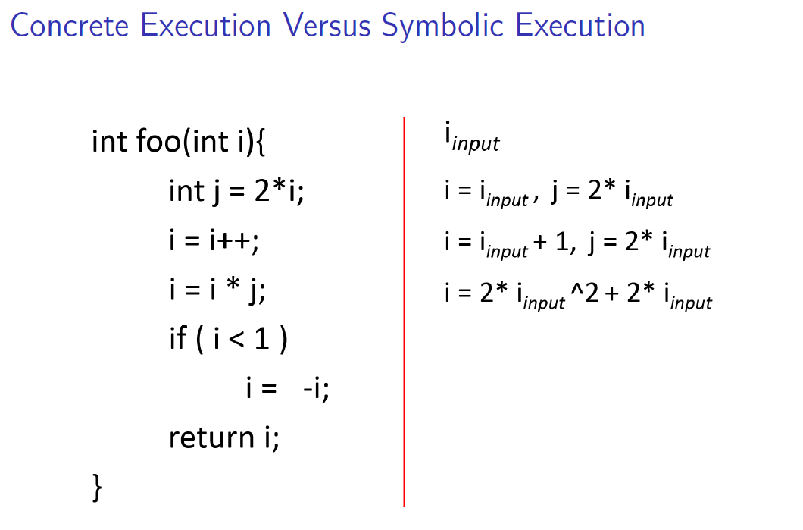

Slide 25
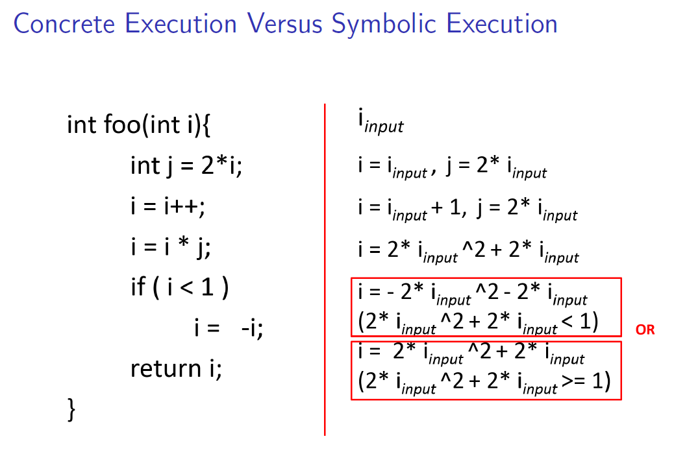

Slide 26
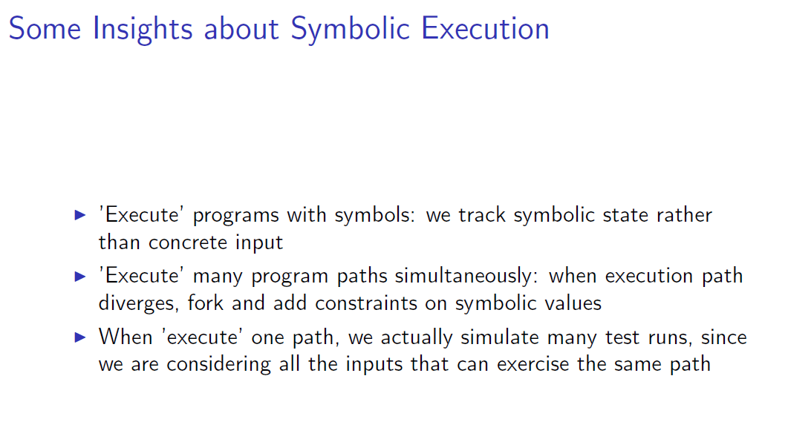

Slide 27
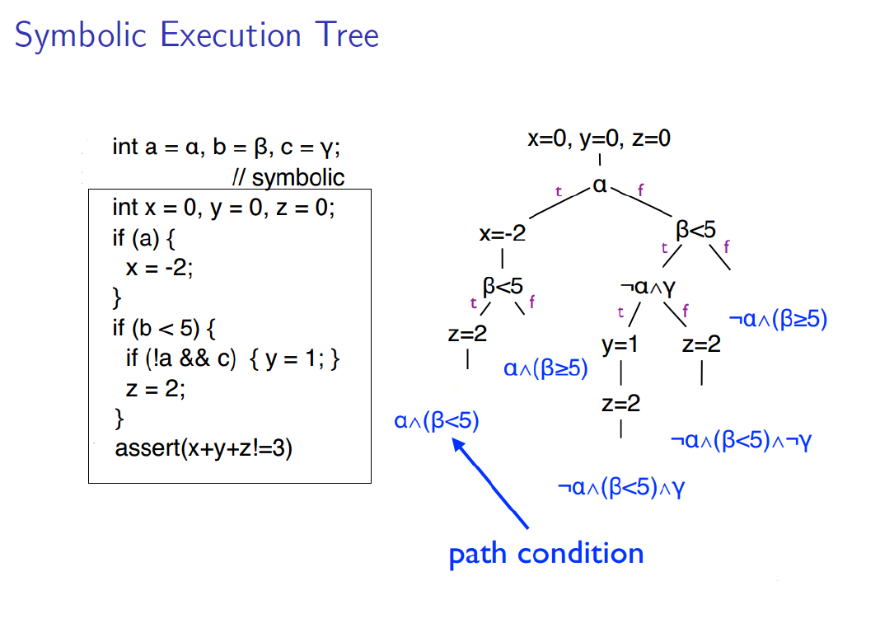

Slide 28
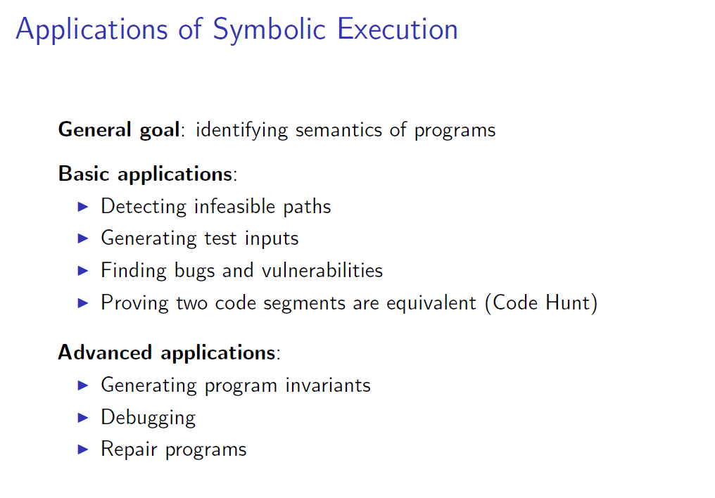

Slide 29
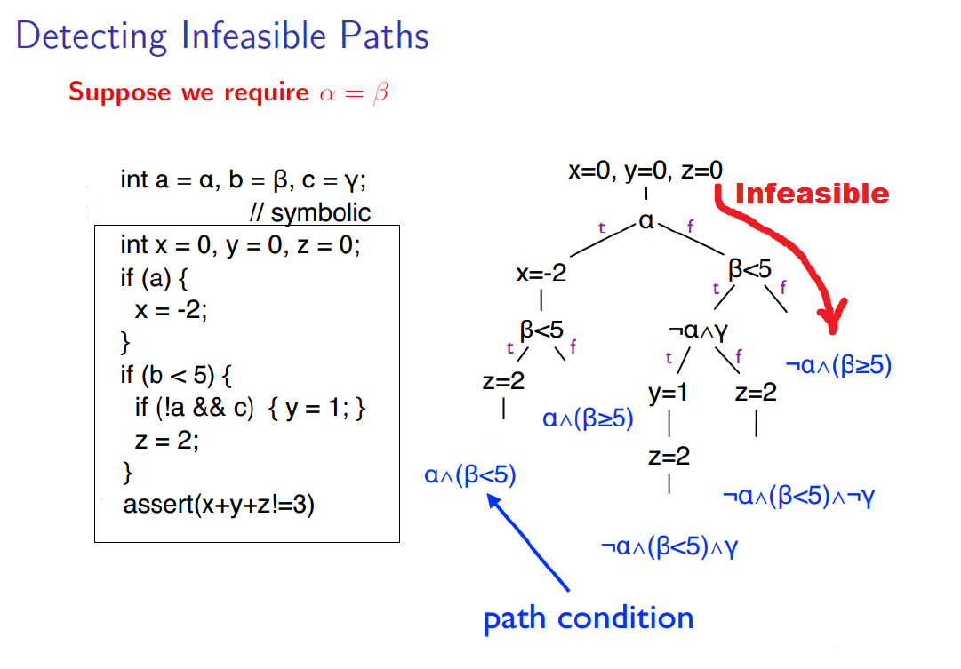

Slide 30
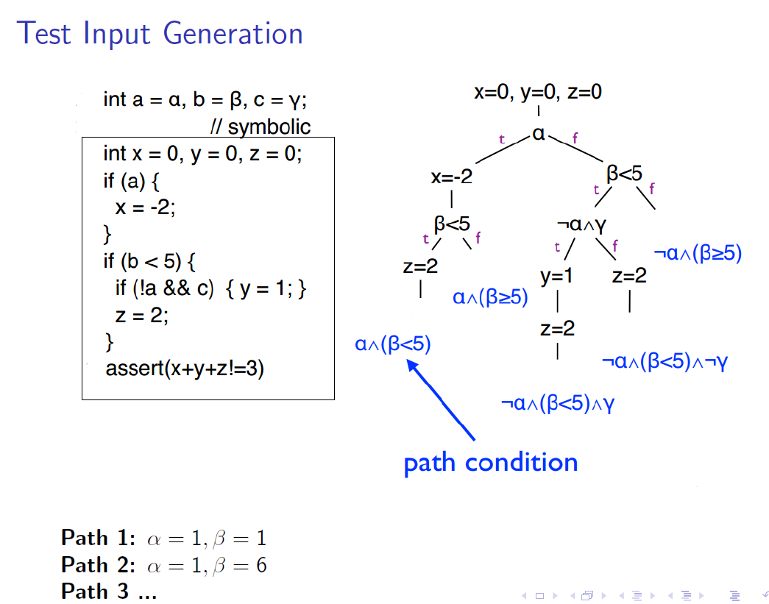

Slide 31
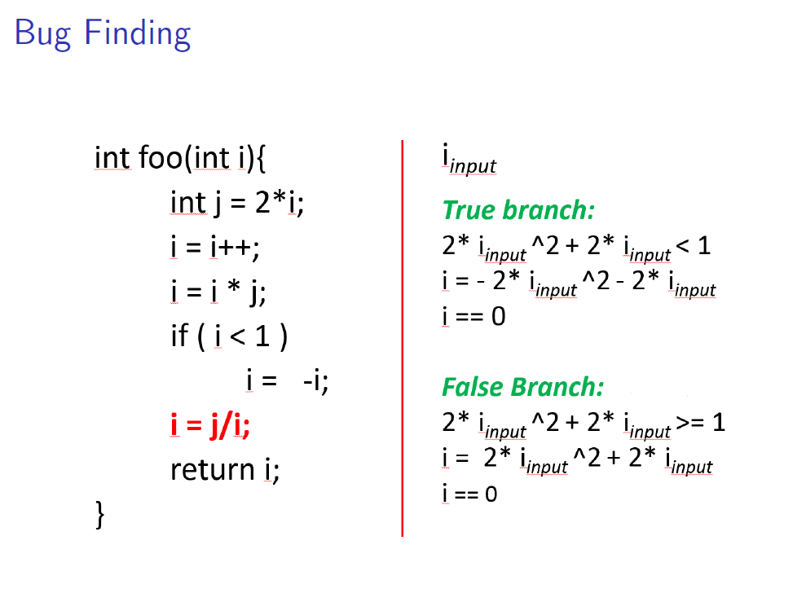

Slide 32
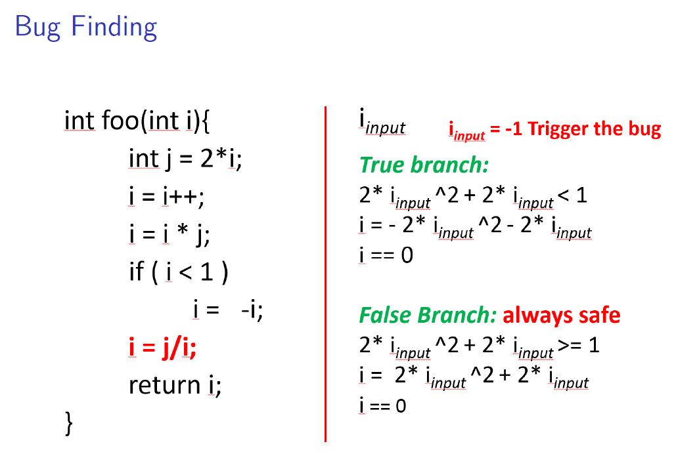

Slide 33
Dynamic Analysis

Slide 34
Normal Dynamic Analysis
Run program in instrumented execution environment
  Binary translator, Static instrumentation, emulator
Look for bad stuff
  Use of invalid memory, race conditions, null pointer deref, etc.

Slide 35
Regression vs. Fuzzing
Regression: Run program on many normal inputs, look for badness.
  Goal: Prevent normal users from encountering errors (e.g. assertions bad).
Fuzzing: Run program on many abnormal inputs, look for badness.
  Goal: Prevent attackers from encountering exploitable errors (e.g. assertions often ok)

Slide 36


Blackbox fuzzing
Random input
Test program
Miller et al. ‘89

Slide 37
Blackbox fuzzing
Given a program simply feed random inputs and see whether it exhibits incorrect behavior (e.g., crashes)
Advantage: easy, low programmer cost
Disadvantage: inefficient
  Inputs often require structures, random inputs are likely to be malformed
  Inputs that trigger an incorrect behavior is a a very small fraction, probably of getting lucky is very low

Slide 38
Fuzzing
Automatically generate test cases
Many slightly anomalous test cases are input into a target
Application is monitored for errors
Inputs are generally either file based (.pdf, .png, .wav, etc.) or network based (http, SNMP, etc.)
Monitor
Input generator
Test application

Slide 39
Problem detection
See if program crashed
  Type of crash can tell a lot (SEGV vs. assert fail)
Run program under dynamic memory error detector (valgrind/purify/AddressSanitizer)
  Catch more bugs, but more expensive per run.
See if program locks up

Slide 40





Enhancement 1:
Mutation-Based fuzzing
Take a well-formed input, randomly perturb (flipping bit, etc.)
Little or no knowledge of the structure of the inputs is assumed
Anomalies are added to existing valid inputs
  Anomalies may be completely random or follow some heuristics (e.g., remove NULL, shift character forward)
Examples: ZZUF, Taof, GPF, ProxyFuzz, FileFuzz, Filep, etc.
?
Seed input
Mutated input
Run test program

Slide 41
Example: fuzzing a PDF viewer
Google for .pdf (about 1 billion results)
Crawl pages to build a corpus
Use fuzzing tool (or script)
  Collect seed PDF files
  Mutate that file
  Feed it to the program
  Record if it crashed (and input that crashed it)

Slide 42
Mutation-based fuzzing
Super easy to setup and automate
Little or no file format knowledge is required
Limited by initial corpus
May fail for protocols with checksums, those which depend on challenge

Slide 43


Enhancement II:
Generation-Based Fuzzing
Test cases are generated from some description of the input format: RFC, documentation, etc.
  – Using specified protocols/file format info
  – E.g., SPIKE，Peach，Sulley，boofuzz
Anomalies are added to each possible spot in the inputs
Knowledge of protocol should give better results than random fuzzing
?
RFC
Input spec
Generated inputs
Run test program

Slide 44
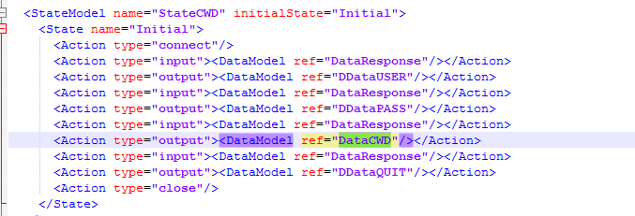
Enhancement II:
Generation-Based Fuzzing
Peach 输入输出状态机
Notes:
https://blog.csdn.net/u012397189/article/details/78122418
模糊测试工具Sulley开发指南（2）——与Peach比较

Slide 45
Mutation-based vs. Generation-based
Mutation-based fuzzer
  Pros: Easy to set up and automate, little to no knowledge of input format required
  Cons: Limited by initial corpus, may fall for protocols with checksums and other hard checks
Generation-based fuzzers
  Pros: Completeness, can deal with complex dependncies (e.g, checksum)
  Cons: writing generators is hard, performance depends on the quality of the spec

Slide 46
How much fuzzing is enough?
Mutation-based-fuzzers may generate an infinite number of test cases. When has the fuzzer run long enough?
Generation-based fuzzers may generate a finite number of test cases. What happens when they’re all run and no bugs are found?

Slide 47
Code coverage
Some of the answers to these questions lie in code coverage
Code coverage is a metric that can be used to determine how much code has been executed.
Data can be obtained using a variety of profiling tools. e.g. gcov, lcov
Notes:
百度百科：代码覆盖测试
语句覆盖(Statement Coverage)，又称行覆盖(Line Coverage)，段覆盖(Segment Coverage)，基本块覆盖(Basic Block Coverage)，这是最常用也是最常见的一种覆盖方式，就是度量被测代码中每个可执行语句是否被执行到了
判断覆盖(Decision Coverage)，又称分支覆盖(Branch Coverage)，所有边界覆盖(All-Edges Coverage)，基本路径覆盖(Basic Path Coverage)，判定路径覆盖(Decision-Decision-Path)。它度量程序中每一个判定的分支是否都被测试到了
路径覆盖(Path Coverage)，又称断言覆盖(Predicate Coverage)。它度量了是否函数的每一个分支都被执行了。 这句话也非常好理解，就是所有可能的分支都执行一遍，有多个分支嵌套时，需要对多个分支进行排列组合，可想而知，测试路径随着分支的数量指数级别增加

Slide 48
Line coverage
Line/block coverage: Measures how many lines of source code have been executed.
For the code on the right, how many test cases (values of pair (a,b)) needed for full(100%) line coverage?
if( a > 2 )
a = 2;
if( b >2 )
b = 2;
  1 test case for line coverage
Notes:
语句覆盖(Statement Coverage)，又称行覆盖(Line Coverage)，段覆盖(Segment Coverage)，基本块覆盖(Basic Block Coverage)，这是最常用也是最常见的一种覆盖方式，就是度量被测代码中每个可执行语句是否被执行到了

Slide 49
Branch coverage
Branch coverage: Measures how many branches in code have been taken (conditional jmps)
For the code on the right, how many test cases needed for full branch coverage?
if( a > 2 )
a = 2;
if( b >2 )
b = 2;
  2 test cases for branch coverage
Notes:
判断覆盖(Decision Coverage)，又称分支覆盖(Branch Coverage)，所有边界覆盖(All-Edges Coverage)，基本路径覆盖(Basic Path Coverage)，判定路径覆盖(Decision-Decision-Path)。它度量程序中每一个判定的分支是否都被测试到了

Slide 50
Path coverage
Path coverage: Measures how many paths have been taken
For the code on the right, how many test cases needed for full path coverage?
if( a > 2 )
a = 2;
if( b >2 )
b = 2;
  4 test cases for path coverage
    i.e. (a,b) = {(0,0), (3,0), (0,3), (3,3)}
Notes:
路径覆盖(Path Coverage)，又称断言覆盖(Predicate Coverage)。它度量了是否函数的每一个分支都被执行了。 这句话也非常好理解，就是所有可能的分支都执行一遍，有多个分支嵌套时，需要对多个分支进行排列组合，可想而知，测试路径随着分支的数量指数级别增加

Slide 51
Benefits of Code coverage
Can answer the following questions
  – How good is an initial file?
  – Am I getting stuck somewhere?
  if (packet[0x10] < 7) { //hot path
  } else { //cold path }
  How good is fuzzerX vs. fuzzerY
  Am I getting benefits by running multiple fuzzers?

Slide 52
Problems of code coverage
For:
  mySafeCopy(char *dst, char* src) {
  if(dst && src)
  strcpy(dst, src); }
Does full line coverage guarantee finding the bug?
Does full branch coverage guarantee finding the bug?

Slide 53
Enhancement III:
Coverage-guided gray-box fuzzing
Special type of mutation-based fuzzing
  Run mutated inputs on instrumented program and measure code coverage
  Search for mutants that result in coverage increase
  Often use genetic algorithms, i.e., try random mutations on test corpus and only add mutants to the corpus if coverage increases
  Examples: AFL, libfuzzer

Slide 54

American Fuzzy Lop (AFL)
Execute against instrumented
target
Seed
inputs
Mutation
Input
queue
Next input
branch/edge coverage increased?
Add mutant
to the queue
Periodically culls the queue without
affecting total coverage

Slide 55
AFL
Instrument the binary at compile-time
Regular mode: instrument assembly
Recent addition: LLVM compiler instrumentation mode
Provide 64K counters representing all edges in the app
Hashtable keeps track of # of execution of edges
  Imprecise (edges may collide) but very efficient
AFL-fuzz is the driver process, the target app runs as separate process(es)

Slide 56
LLVM
LLVM项目是模块化、可重用的编译器以及工具
有些文章把LLVM当做Low Level Virtual Machine(低级虚拟机)的缩写简称，
官方描述如下
The name "LLVM" itself is not an acronym; it is the full name of the project. “LLVM”这个名称本身不是首字母缩略词; 它是项目的全名。

Slide 57
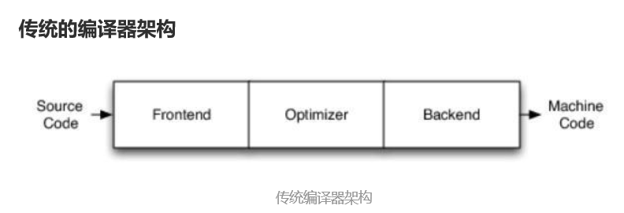
传统编译器架构
Frontend:前端
词法分析、语法分析、语义分析、生成中间代码
Optimizer:优化器
中间代码优化
Backend:后端
生成机器码

Slide 58
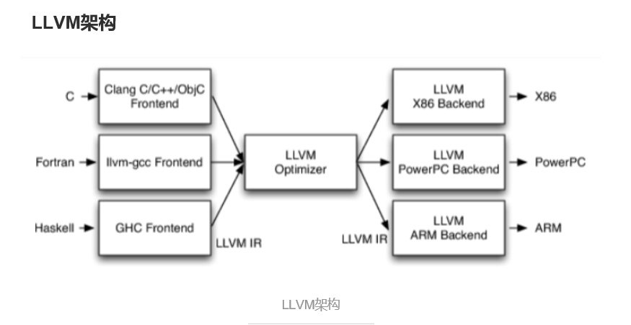
LLVM架构

Slide 59
LLVM特点
不同的前端后端使用统一的中间代码LLVM Intermediate Representation (LLVM IR)
如果需要支持一种新的编程语言，那么只需要实现一个新的前端
如果需要支持一种新的硬件设备，那么只需要实现一个新的后端
优化阶段是一个通用的阶段，它针对的是统一的LLVM IR，不论是支持新的编程语言，还是支持新的硬件设备，都不需要对优化阶段做修改
相比之下，GCC的前端和后端没分得太开，前端后端耦合在了一起。所以GCC为了支持一门新的语言，或者为了支持一个新的目标平台，就 变得特别困难
LLVM现在被作为实现各种静态和运行时编译语言的通用基础结构(GCC家族、Java、.NET、Python、Ruby、Scheme、Haskell、D等)

Slide 60
Fuzzing challenges
How to seed a fuzzer?
  Seed inputs must cover different branches
  Remove duplicate seeds covering the same branches
  Small seeds are better
Some branches might be very hard to get past as the # of inputs satisfying the conditions are very small
  Manually/automatically transform/remove those branches

Slide 61
Hard to fuzz code
void test (int n) {
if (n==0x12345678)
crash();
}
needs 2^32 or 4 billion attempts
In the worst case

Slide 62
Make it easier to fuzz
void test (int n) {
int dummy = 0;
char *p = (char *)&n;
if (p[3]==0x12) dummy++;
if (p[2]==0x34) dummy++;
if (p[1]==0x56) dummy++;
if (p[0]==0x78) dummy++;
if (dummy==4)
crash();
}
needs around 2^10 attempts

Slide 63
Fuzzing rules of thumb
Input-format knowledge is very helpful
Generational tends to beat random, better specs make better fuzzers
Each implementation will vary, different fuzzers find different bugs
  More fuzzing with is better
The longer you run, the more bugs you may find
  But it reaches a plateau and saturates after a while
Best results come from guiding the process
Notice where you are getting stuck, use profiling (gcov, lcov)!

Slide 64
Summary
To find bugs, use the tools and tactics of an attacker
Fuzzing and static analysis belong in every developers toolbox
Field is rapidly evolving
If you don’t apply these tools to your code, someone else will

Slide 65

The Future of Fuzz

Slide 66
Outstanding Problems
What if we don’t have a spec for our protocol/How can we avoid writing a spec.
How do we select which possible test cases to generate

Slide 67

Whitebox Fuzzing
Infer protocol spec from observing program execution, then do generational fuzzing
Potentially best of both worlds
Bleeding edge

Slide 68
How do we generate constraints?
Observe running program
  Instrument source code
  Binary Translation
Treat inputs as symbolic
Infer contraints

Slide 69
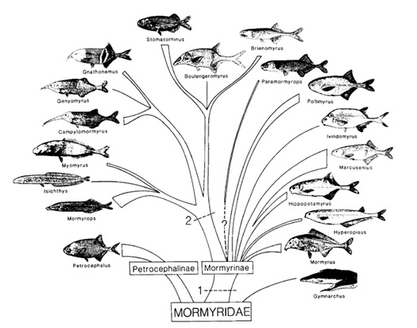
Greybox Techniques
Evolutionary Fuzzing
Guided mutations based on fitness metrics
Prefer mutations that give
  Better code coverage
  Modify inputs to potentially dangerous
  functions (e.g. memcpy)
EFS, autodafe

